Slide 1


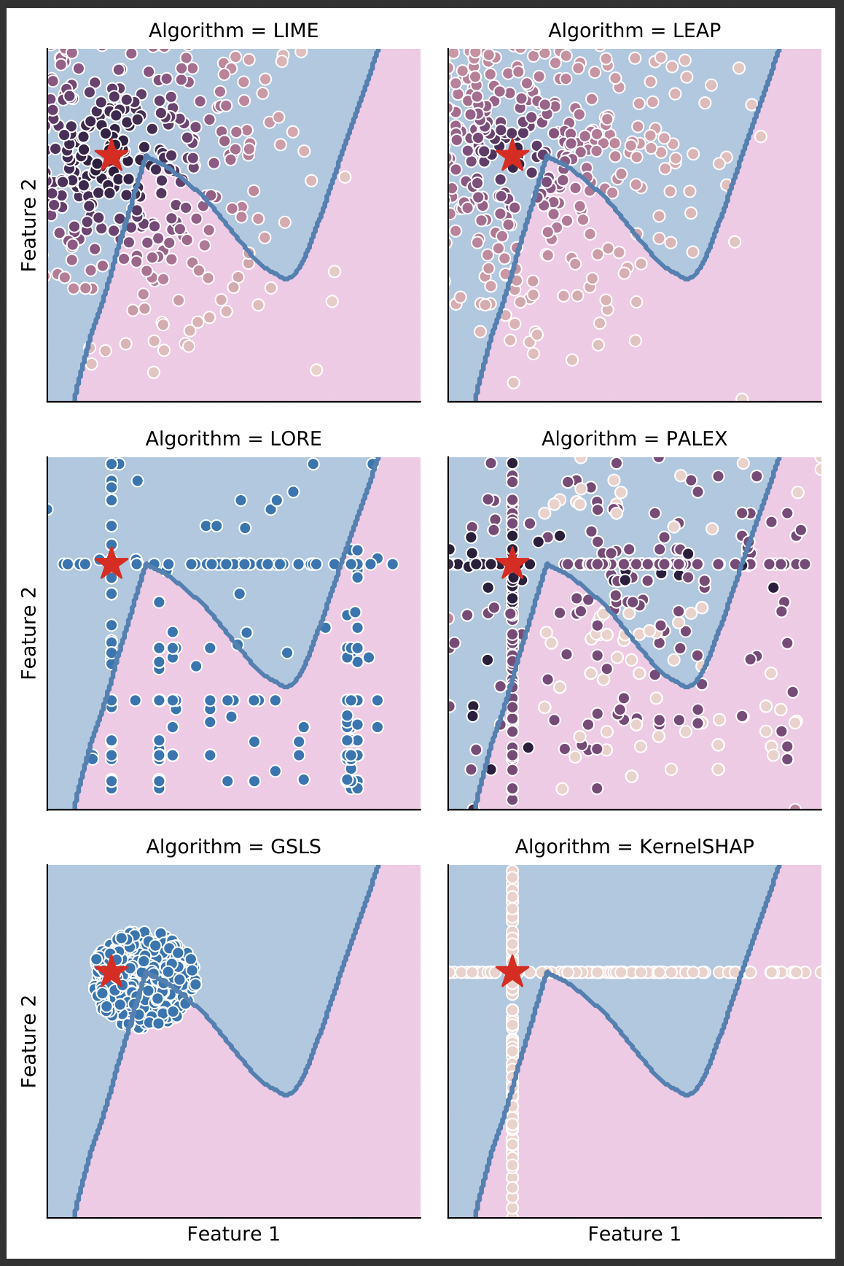
On the overlooked issue of defining explanation objectives for local-surrogate explainers
Similar objective: local interpretable surrogates to explain a prediction.
Similar pipeline
Different information sampled for the neighbourhood.
Different explanations produced.
What properties should these models possess?
What does `locality’ mean? And, how should it be evaluated?
Interpretability approaches tend to be misunderstood and followed blindly.
Practitioners confronted with conflicting explanations with no way of comparing, or evaluating the methods.
Rafael Poyiadzi*, Xavier Renard*, Thibault Laugel, Raul Santos-Rodriguez, Marcin Detyniecki

